Slide 1





Labour Market Information and Pathways
Leicester and Leicestershire
Notes:
This presentation can be delivered in approximately 30 minutes. Please contact anna.scull@llbsp.org.uk if you would like support delivering it for the first time to parents and carers. There are slides which are only appropriate for schools, please delete and adapt where require.

Slide 2

The World of Work
What is the Labour Market?
What skills and qualifications employers are looking for
Which industries are recruiting and where they are located
The number of people in certain types of jobs
Growing or declining job areas and employment trends

Slide 3






What is changing? | How can it affect jobs? | Impact | Which job areas will be important?
New technology is being developed all the time | Loss of some traditional jobs | Change in skills needed | Electronics, Robotics, Cyber Security & Data Science
People are living longer | More support needed for people | Large demand for health and social care | Health Care, Social Care, Life Sciences, Pharmacology
Pace of change is speeding up | New skills need to be learnt quickly | Exciting new opportunities, AI and new technology | Innovation is desperately needed – flexibility, problem solving
The skills around the world are improving | More competition | IT enables people to be delivering work here from other countries | Education, Science, Engineering, Creative and Media, Finance
Environmental awareness is growing | Research and development on energy saving | Wide variety of roles in all sectors, skilled engineers and mechanics | Engineering, Chemical Processing, Energy & Utilities
Increase in well-being and leisure | Demand for catering, health and fitness and gaming | Growth in tourism, spa facilities & fitness | Health & Beauty, Sport and Leisure, Hospitality
Notes:
How is the world of work changing to meet the needs of the future?

Slide 4




Look at Leicester and Leicestershire
Why work for a smaller business? – Input valued / more variety / quick progression / more contact with senior managers – greater impact
Employers locally say…
Value young people with good communication skills & strong work ethics
Useful skills include digital, problem solving, adaptability
Be open to different sectors, there are a range of opportunities in most sectors
Ideally 5 good GCSE results including English, Maths & Science – strengthened with skills and personality!
Work experience or voluntary experience is valued
Notes:
Emphasis on the employers ask – skills and qualities

Slide 5



Health & Social Care
Useful subjects: Maths, English, Science, ICT, Psychology, Sociology
Over 350 different careers in the NHS
The NHS is the employer that advertises the most jobs locally
Leicestershire is world renowned for services in Cardiovascular and Respiratory Medicine
Growing use of technology in Health and Social Care
Communication and strong people skills are highly valued!
22% of roles locally are in nursing – 94% of graduates are in work within 3 months and UK qualifications are internationally recognised.
Pathways – GCSE, T-Levels / Apprenticeships / A-Levels / Degree
Notes:
Each sector is introduced and followed by a second page of local employers – if time allows click on a local employers page and highlight any early careers opportunities such as apprenticeships.

Slide 6

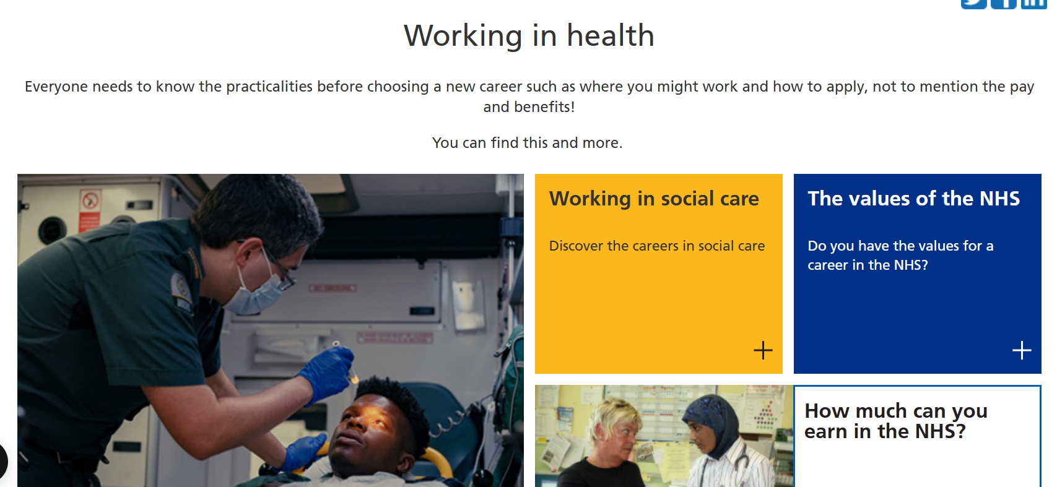
Health & Social Care
Inspired to Care – Your journey to a career in social care
Explore Roles
Take a Careers Quiz
Career Planning
Working in health | Health Careers

Slide 7


Creative
Useful subjects: English, Maths, ICT, Art & Design, Media
The sector is all about generating original ideas and products
Arts / Culture / Creative Media
Jobs include Design, Film & Video Production / Marketing / Advertising / Computer Game Development / Animation
Shortages in Skills – 3D Designers, Digital Media / Broadcast Engineers
Check out - Rock Kitchen Harris / Twist and Shout / Colab Creation / Bulb Studios
Pathways – T-Level in Digital, Design and Development / high percentage of graduates in the sector

Slide 8

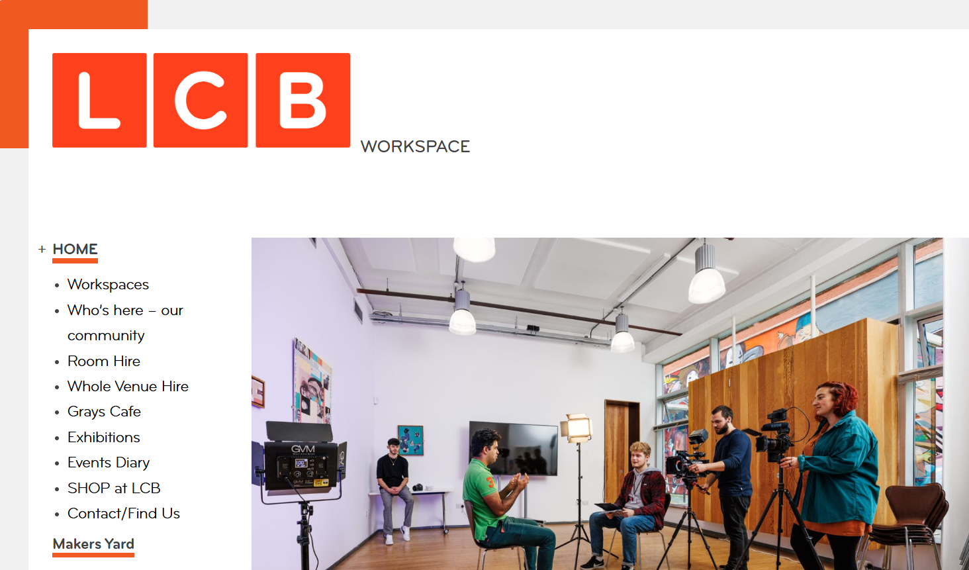

Local Creative Industry
Careers & Current Vacancies | Rock Kitchen Harris
Home - lcbdepot.co.uk
Digital Product Agency | Digital agency in the UK | Bulb Studios

Slide 9






Sport and Physical Activity
Useful subjects: Biology, Maths, PE, Chemistry, English
Range of opportunities include coaching, analysing performance, developing sport related businesses, nutritionists, grounds keepers
Leading sporting teams – Leicester City Football Club / Leicester Tigers / Leicester Riders / Leicester Hockey Club
Loughborough University is ranked number 1 in the world for sports related subjects
Pathways – Top skills include communication & teamwork
Volunteering is a great way to access the sector
Apprenticeships available

Slide 10


Sport and Physical Activity
Careers - Youth Sport Trust
Sports | Sport | Loughborough University

Slide 11


Engineering and Advanced Manufacturing
Useful subjects: Maths, Physics, ICT, Design Technology
Second highest paying sector in the area, accounts for 11% of the regions workforce
Careers include Research, Testing, Developing Prototypes, Production Engineering & Maintenance
Predicted skills shortage in 10 years time / a change in skillset required
Loughborough Science Park and MIRA Technology Park leading research and development in Europe
Pathways – Routes in at all levels. Vocational learning is highly valued. Apprenticeships available!

Slide 12

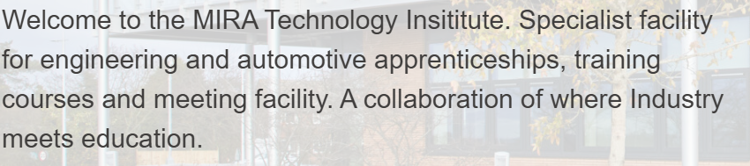
Engineering and Advanced Manufacturing
Apprenticeships advertised on the Mira Technology website. L2 to Degree Level available.
Apprenticeships Archives - Page 2 of 3 - MTI
Caterpillar | Desford Apprenticeship Opportunities

Slide 13




Digital
Useful subjects: Maths, Computing, ICT, Design Technology
Fast growing future proof sector
AI is profoundly impacting the sector
Skills are highly valued – highest average wage compared to other sectors – much in demand
Cyber Security skills, coding, data analytics are in demand!
Pathways – All sectors require Digital Skills. Apprentice IT technician, Digital Content roles, Website design.

Slide 14

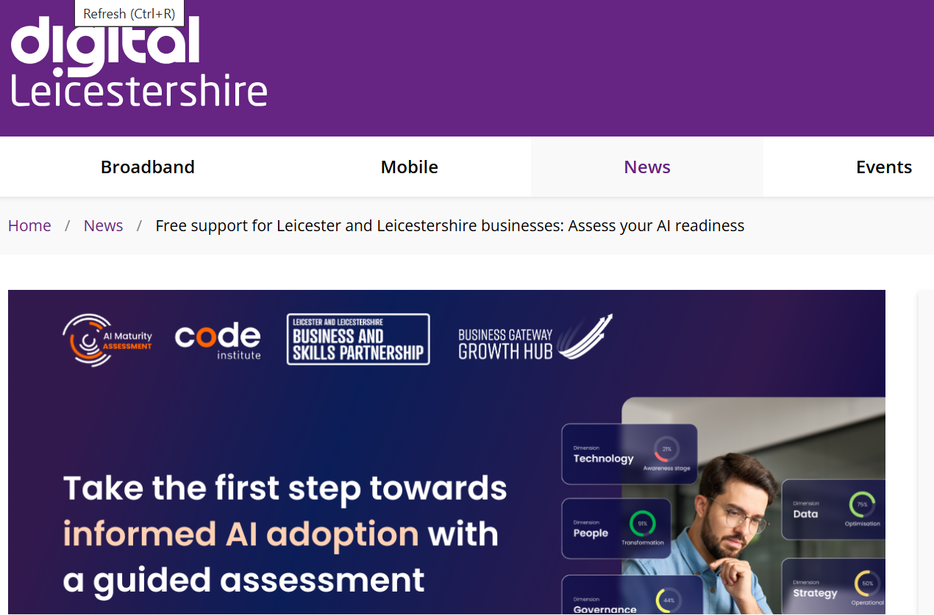
Digital
Managed IT Support Leicester from Realtime IT Solutions
Free support for Leicester and Leicestershire businesses: Assess your AI readiness - Digital Leicestershire

Slide 15



Logistics & Distribution
Useful subjects: Maths, Business and Admin, ICT, Languages
Golden Triangle of Logistics – transport network
Sector is set to grow by 10% by 2023
Magna Park is Europe’s largest distribution centre and East Midlands Airport is the UK base for FedEx, DHL and UPS – the UKs busiest cargo airport
Problem Solving Skills Adaptability and Calm under Pressure are highly valued!
Pathways – Entry Level include Distribution Clerk, Customer Services. Apprenticeships & Graduate schemes in planning and purchasing

Slide 16



Logistics & Distribution
Pall-Ex UK | Palletised Freight Distribution
Generation Logistics | Where Talent Meets Opportunity
Magna Park Lutterworth

Slide 17

Construction
Useful subjects: Maths, Sciences, ICT, Design Technology,
A highly dynamic and critical sector, includes the planning, designing and construction of buildings, infrastructure including roads and railways. Employs nearly 30,000 people locally and if wiling to travel offers high wages and great opportunities to progress.
Local companies offer great apprenticeship opportunities including – Ibstock Brick, Caterpillar, Breedon Group and Aggregate Industries.
Sector to grow by 14.8 % by 2030 – housebuilding!
180 different roles in the sector, including HR / Marketing / Surveying
Pathways – Over 30 different apprenticeships in the sector locally. Construction Skills Hub can offer local support – www.leicesteremploymenthub.co.uk

Slide 18


Construction
Skills Bootcamps
Early Careers - Ibstock

Slide 19


Space
Useful subjects: Maths, Sciences, Geography, IT
One of the fastest growing sectors locally! Leicester and Leicestershire is the UKs leading location for space.
Space information and research informs our modern life including medical devises, SatNav, climate monitoring and high-speed communications!
2nd largest campus-based cluster with a dedicated space focus in the UK. Strong links with Leicester University. Home - Space Park Leicester
Home - Space Park Leicester
Pathways – Most careers need high level engineering, maths and science qualifications. UKs first post 16 Space Engineering course offered by Loughborough College

Slide 20

Options after leaving school post 16
P16
Stay in full-time education, e.g. at a college, doing A Levels, T Levels or other Vocational Technical Qualifications – Cambridge Technical, BTEC
Start an Apprenticeship
Work or volunteer for 20 hours or more a week while in part-time education or training - at least 280 guided learning hours (GLH) per year. This means the equivalent of about one day a week spent being taught by a lecturer, supervisor or tutor
P 16
Notes:
A brief intro to the main 3 routes for post 16. Greater detail to follow in the next handful of slides.

Slide 21
Options – Post 18
Stay in full-time or part-time education, an Undergraduate Degree or Higher Technical Qualifications (more practical, employer led programme of study)
Start an Apprenticeship – L3 upwards, Degree Apprenticeships
Enter Full Time Employment – look for internal training opportunities
Gap Year – work, volunteer, develop your skills
P 18

Slide 22
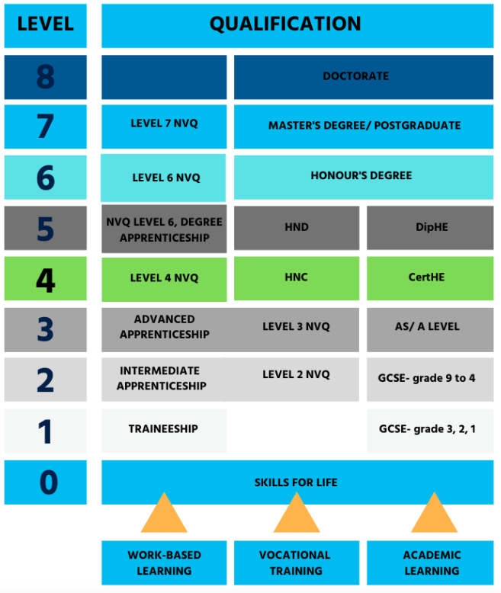
Levels Explained
Qualifications Explained - Leicester College
Notes:
Demonstrate where the GCSE grades 1-3 and grades 4-9 sit within the 0-8 level.

Slide 23
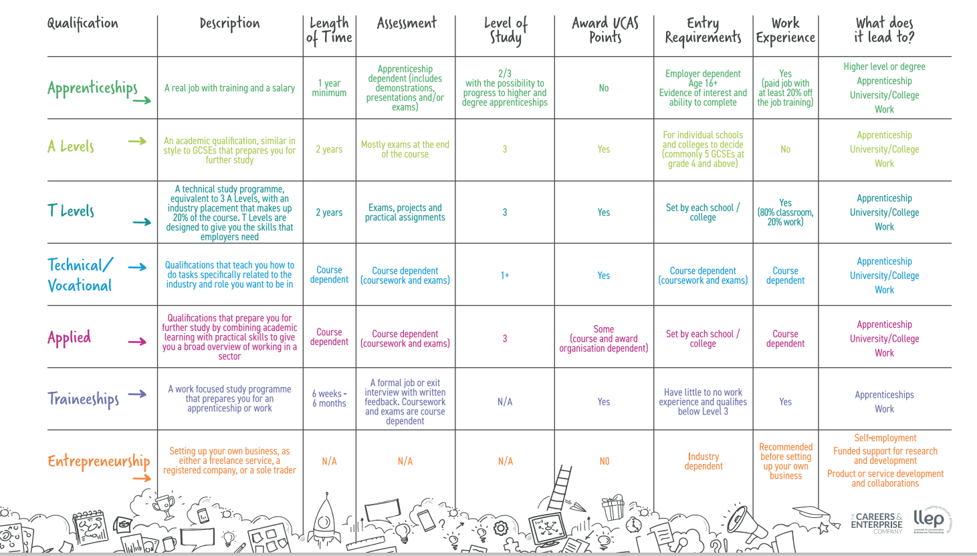
Pathways
Pathways Poster_Proof C

Slide 24


Apprenticeship
A paid role that combines on the job training with formal study to gain a nationally recognised qualification
Apprentices learn by doing and are paid a wage and receive holiday pay
Apprentice
70% of all occupations can now be entered by an apprenticeship
Employer
Training Provider
6 hours per week of paid study time, learn with the training provider (ITP, University, College)
Find an apprenticeship - GOV.UK
Notes:
If time allows, click on the PS16 website – enter school postcode and search for local apprenticeships. Reinforce that anyone can access this information and Year 10 / 11s will be given an account via school.

Slide 25

Supported Internship
A structured work-based study programme for 16–24-year-olds with SEND, who have an EHC plan.
A substantial work placement facilitated by the support of an expert job coach
Supported interns are in full-time education and their supported internship work placements are part of their course.
Minimum of 6 months, up to a year.
The measurement of SI is transition to sustained and paid employment.
Supported internship | LCC Family Hub
Notes:
For parents and carers of children with SEND and an EHC plan.

Slide 26

T-Levels
Equivalent to 3 A Levels, focuses on vocational skills and academic knowledge
Designed with leading businesses – 250 involved in planning and delivering
A 45-day industry placement
80% Classroom 20% in industry
Agriculture, Environmental and Animal Care | Business and Administration | Construction | Creative and Design | Digital
Education and Early Years | Engineering and Manufacturing | Health and Science | Legal, Finance and Accounting | Sales, Marketing and Procurement

Slide 27

Explore all the post 16 options – consider preferred learning styles, motivation, pathways to jobs
Interests and strengths – subjects, skills, behaviours *practise talking about themselves in a positive light! Add examples
Ask about work experience and volunteering options – inside and outside of school
Attend a wide range of open days – when the time is right
Notes:
Suggested take – aways, things to consider for parents and carers, you may wish to add your own.

Slide 28


